Slide 1


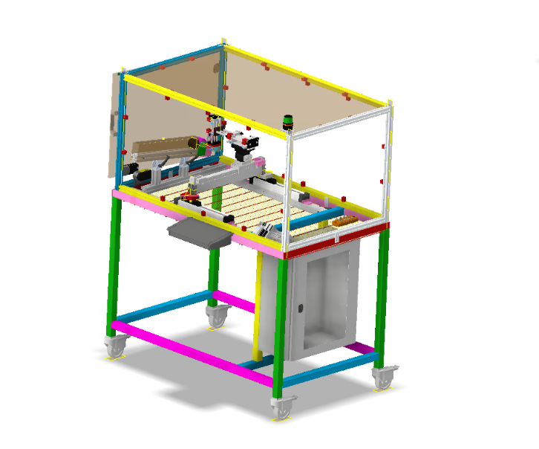
2022 Project
Napkin Ring Sorting Machine

Slide 2

Machine Overview
Function 5-6 (Communication)

Slide 3
System Functions |  | Description | PC | PO | Etudiants Marmande
Making the system mobile All students participate in the design of the lower chassis | Function 1 Bringing parts and entering the transfer area Chassis | Chargeur pièce Ouverture fermeture Pince Avancer Pince | Electric/tire diagram Sensor Layout Cabling Programming | Lower Chassis Define Product Charger | Alexis Antoine
 | Function 2 Moving the Gripper | -Vérin guidé (horizontalement et verticalement) 2 ILS OTB | Electric/tire diagram Sensor Layout Cabling Programming | Drawing the two cylinders Gripper (gripper, jaw) OTB (Implementation) | Nicolas
 | Function 3 Move gantry to sorting area | Deux vérins parallèles 2 ILS 1 Distributeur | Electric/tire diagram Sensor Layout Cabling Programming | Drawing two rodless cylinders | Romain
 | Function 4 Turn the clamp and sort the workpiece | 1 vérin rotatif |  | Drawing Rotary Clamp
 | Function 5 Secure the operation of the system And Process Data Upper Chassis | Carter API + Switch + com IHM Remplacement de toutes les entrées par des cellules IO link | Electrical scheme Sensor Layout Cabling Sistema Study Implementation of security features Network configuration Programming | Upper frame (profiles, polycarbonate, doors) | Nathan
 | Function 6 Communicate | HMI + ARU + light column + Installation of elements on the console | Electrical scheme Layout of the elements Cabling Sistema Study Network configuration Programming | Assembly (Ihm, light column, lectern) | Clément

Slide 4






MOE/MOS
230V alternatif
6 bars
ELEC
AIR
Napkin ring sorting
BAC 1
BAC 2
Chargeur
Dechets
Unsorted napkin ring
Sorted napkin ring

Slide 5
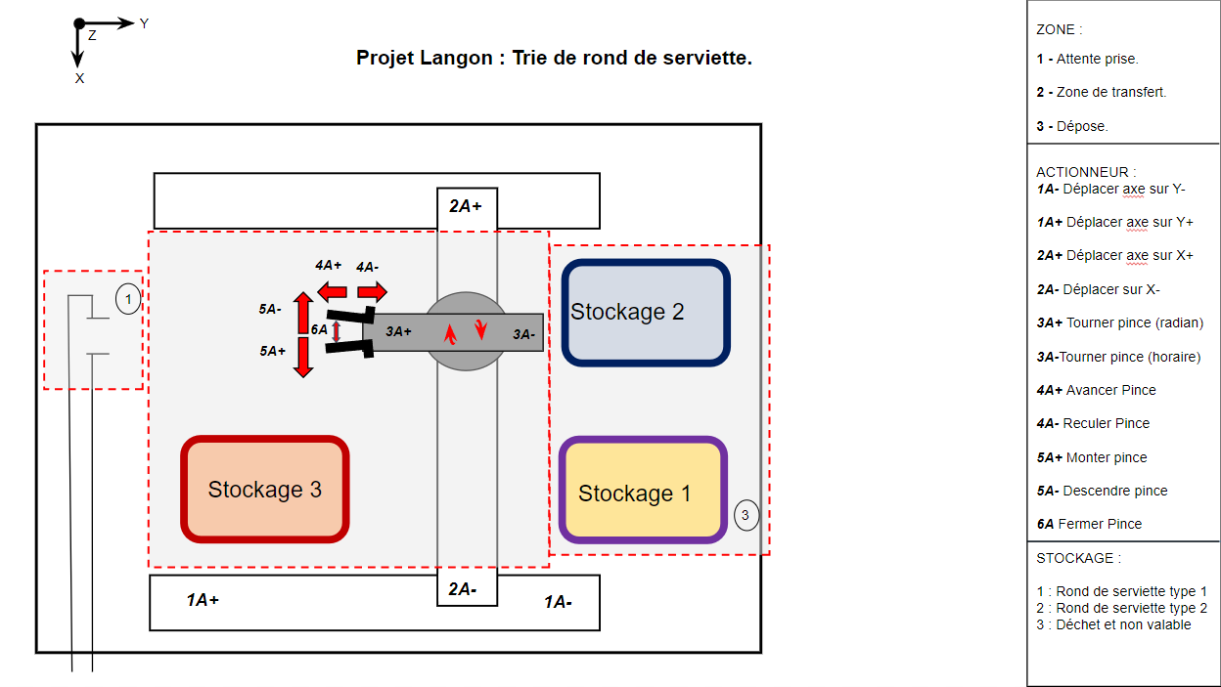

Slide 6
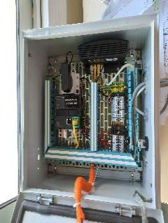
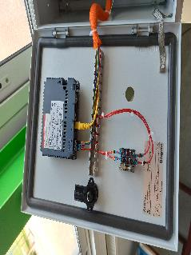
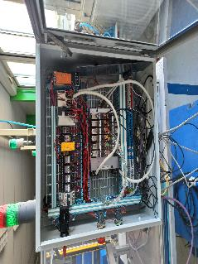
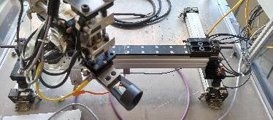
État du système à sa réception en octobre 2021.
Armoire 1 (Elec et pneumatique)
Armoire 2 (Elément de communication)
Retrofitted to the secondary cabinet (-Removal of the secondary cabinet for wiring facilitation -Reprogramming of the ihm)
Unwired column and customer-desired change (column change)
Zone Opérative
Unwired Actuator (Refurbishment Request)
Safety wiring not wired (ARU), link between the M221 and the faulty HMI (refurbishment required)

Slide 7
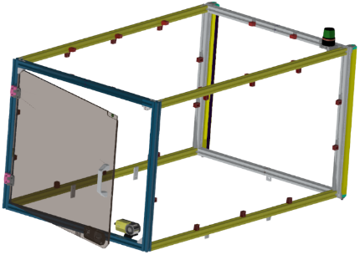
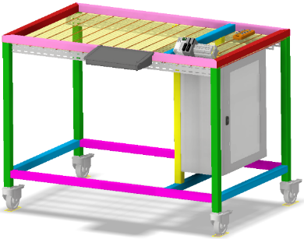
Equipment in liability
Light column
Vérin translation sur X
Terminal x3: light column
Cupboard: - Security (ARU) - HMI-AUTOMATE link-
Desk
- "Industrial" machine for educational purposes whose function is to sort pieces by color (napkin ring) -

Slide 8
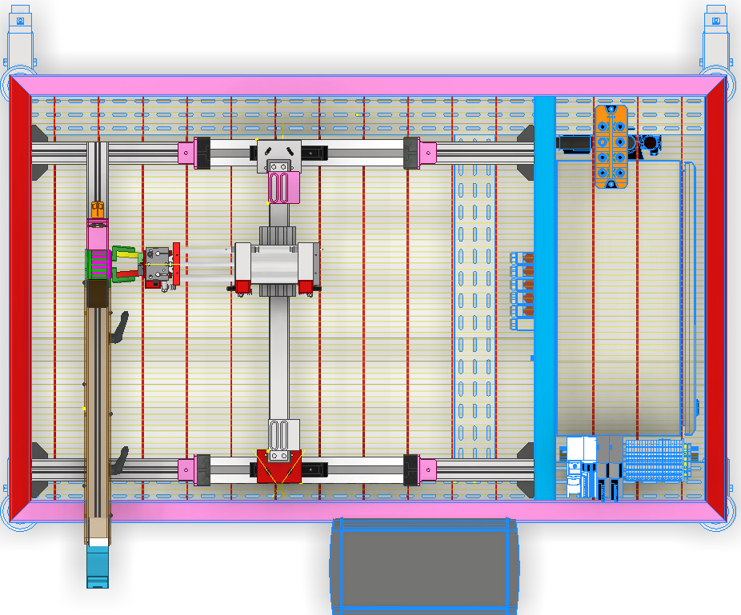
Material in liability "Top view"
Vérin translation sur X
IO-Link master
Cupboard: - Security (ARU) - HMI-AUTOMATE link
ARU
Pupitre

Slide 9
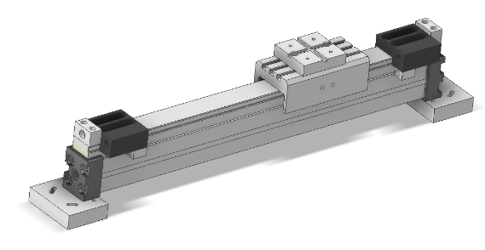
LE VERIN « TRANSLATION SUR X »
The Actuator :

Slide 10
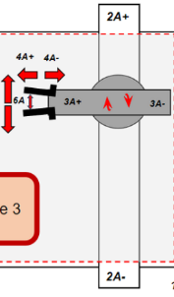
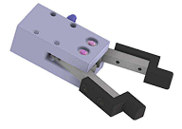
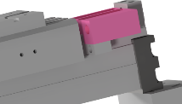
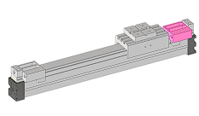
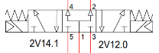
Functional Analysis Table
Function
Effector
Actuator
Pre-actuator
Sensor
Move the Clamp Holder + Clamp on the X&&& axis
Rodless cylinder, double acting, X-translation
Electro-pneumatically operated mono-stable 5-3 valve with pressure centre
Inductive sensor
"Allows you to know the position of the cylinder"
The bits of La Pince
REFERENCE :
REFERENCE :
3F1AN001AP-0260
REFERENCE :
REFERENCE : inconnue

Slide 11
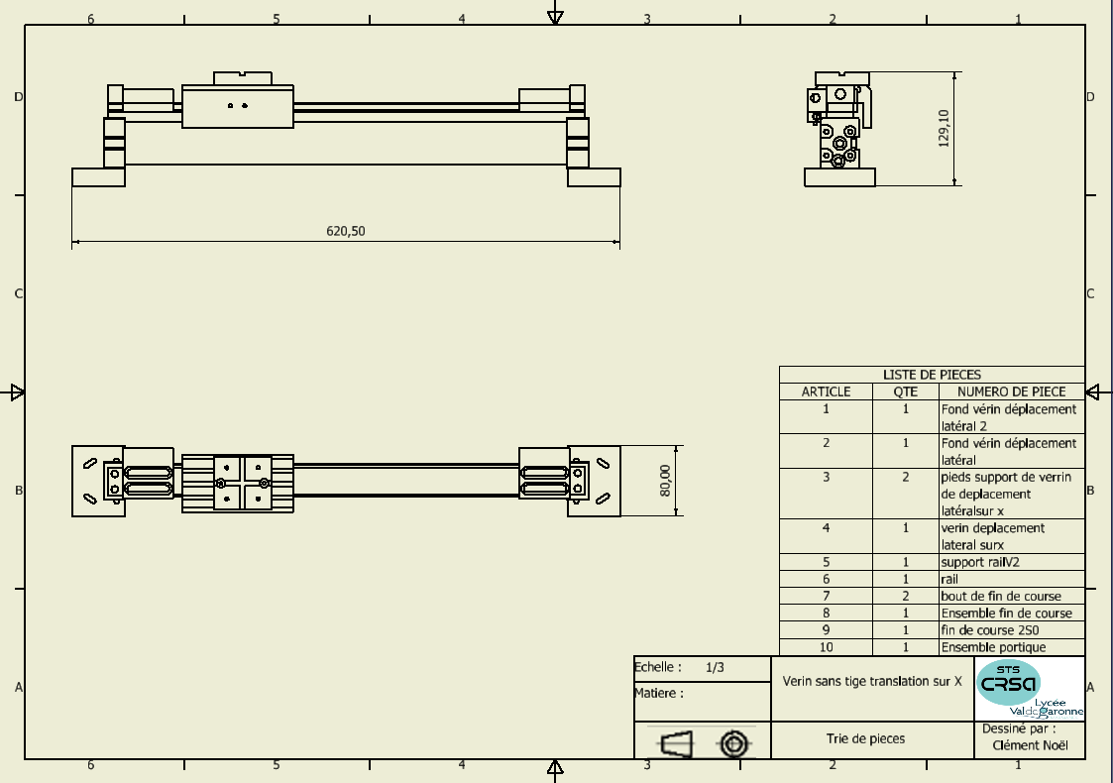
Vérin « Translation sur l’axe X »
Reference : 3FAN Porteur Pneumatic course de 260 mm
Support pince
Stop
Inductive sensor support
Mounting Foot

Slide 12
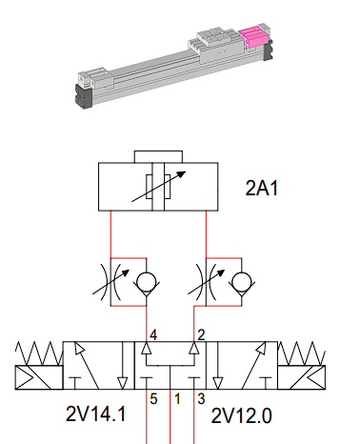
Pneumatic diagram
Double-acting single-rod cylinder on X-shift
Vérin
Pressure-powered cylinder constant air (6bars) The positions are reported by the inductive sensors The speed management of the rectilinear translation movement is regulated by RDUs. to the exhaust.
RDU
DISTRIBUTEUR PNEUMATIQUE

Slide 13
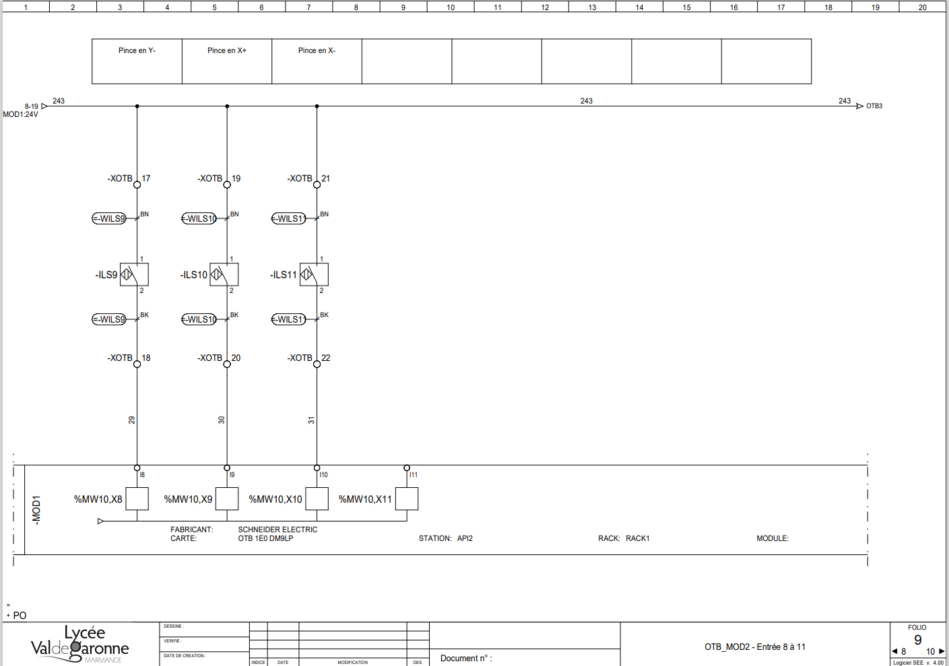
Schéma Electrique
ILS
Entrée de l’OTB

Slide 14
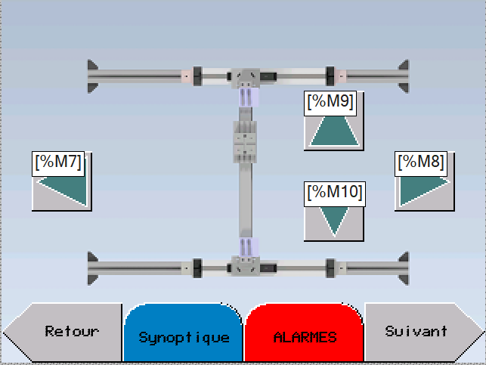
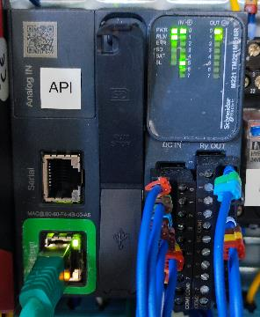
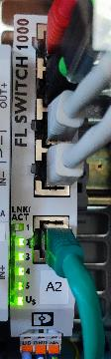
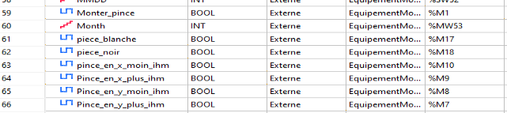
Synoptique vérin sur axe X partie 1
Press the buttons on the HMI to perform an action.
Communication en modBUS TCP Between HMI and PLC
Sends a word to the OTB to enable the output.
Communication between API and OTB

Slide 15
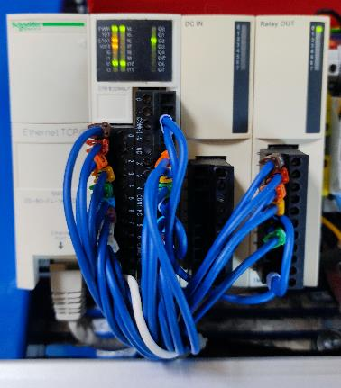
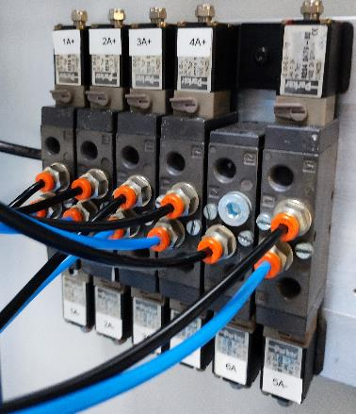
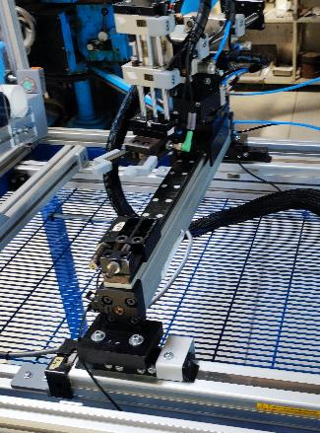
Synoptique vérin sur axe X partie 2
2A+
2A-
The OTB serves as a remote input/output for the PLC and also controls the pneumatic ILO, To activate the 2A+ or 2A coil - it activates the output 3 or 4, (RelayOUT)
The 5-3 mono-stable/pressure center valveelectro-pneumatically controlled
The cylinder supports the movement of the gripper support (and the gripper) on the X-axis

Slide 16
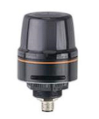
THE COLUMN LIGHT

Slide 17
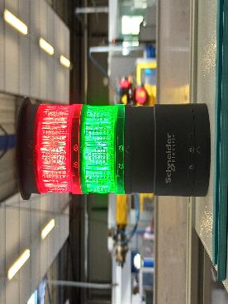

COLONNE LUMINEUSE
Old Solution:
Solution adopted:

Slide 18

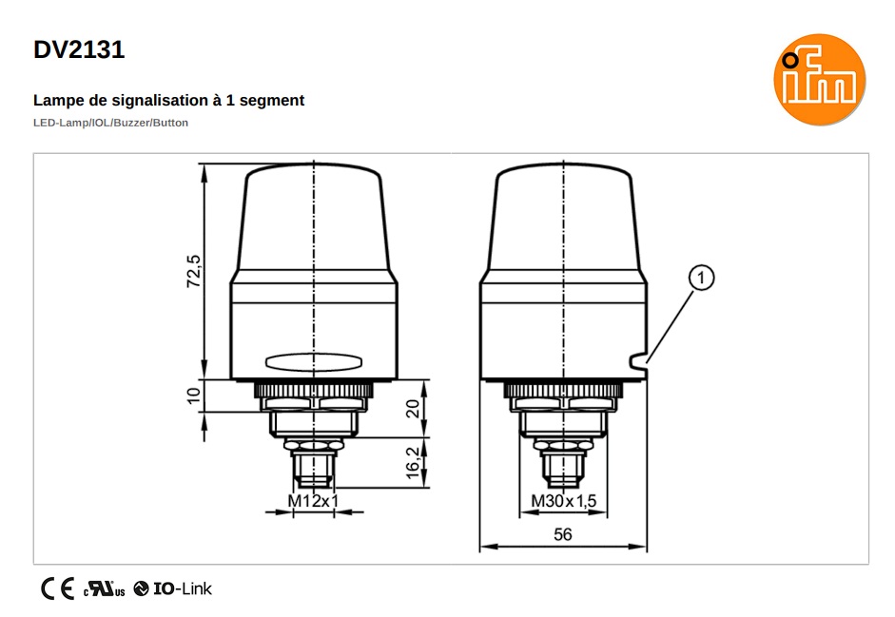
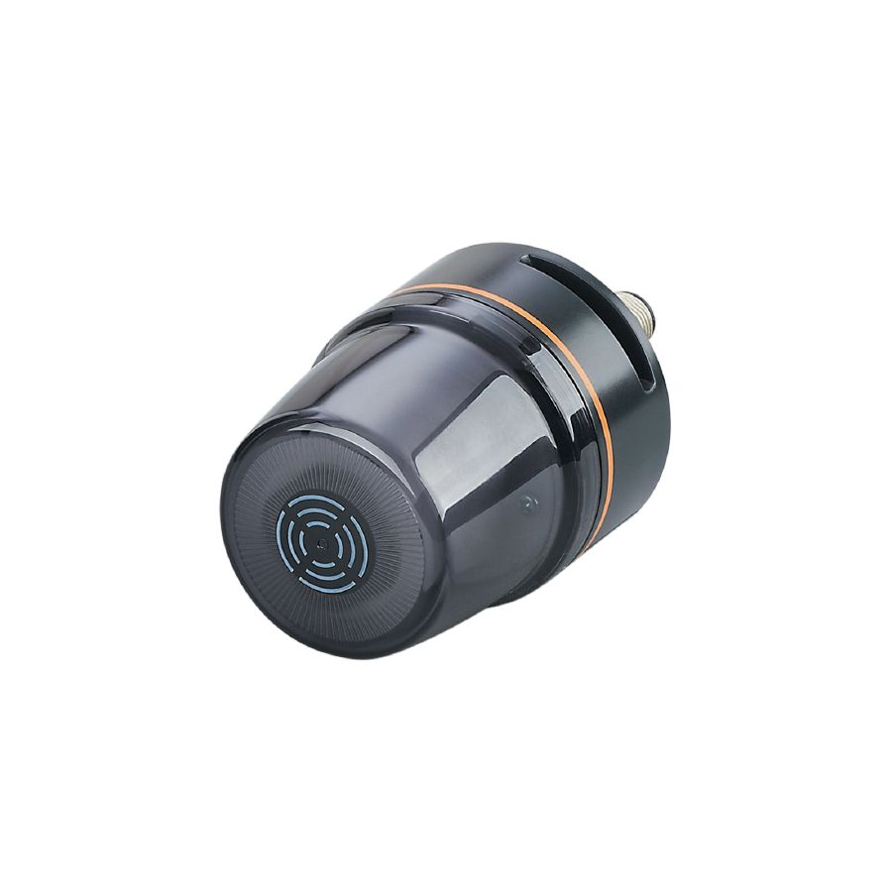
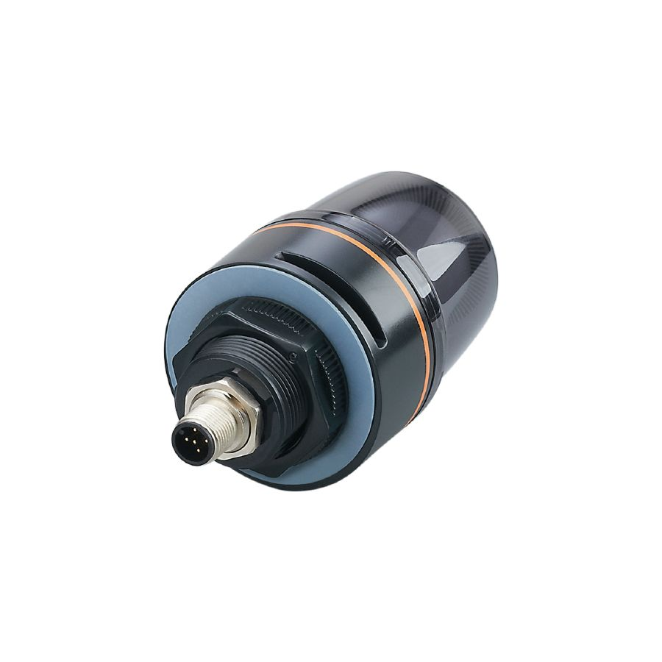
1-Segment Signal Lamp (DV2131)
Voyant RGB 7Couleurs
Fixation avec écrou M30
Bouton capacitif
Connexion IO-LINK
Rated voltage: 24 V DC average power consumption 90mA

Slide 19



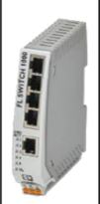
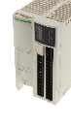
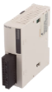
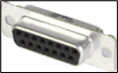
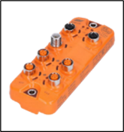
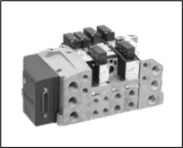
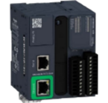
Network Architecture
PC IP: Changes depending on the material
Logiciel EcoStructure Machine Expert Basic
IHM Magelis
IP: 192.168.0.2
Réf :HMIS5T
Modbus TCP (RJ45)
OTB Schneider
IP: 192.168.0.4
Réf: OTB1E0DM9LP
Switch
Réf : FLSWITCH1000
Maître IO Link
IP: 192.168.0.250
Réf: AL1340
SUB-D 15
Automate Schneider
IP: 192.168.0.3
Réf: TM211ME16R
Distributeur
Light Column (X1) Laser Sensor (X3) Pressure sensor (X4)
Vérin

Slide 20
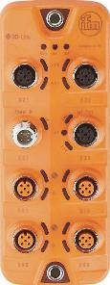
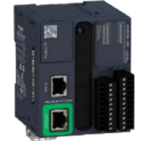
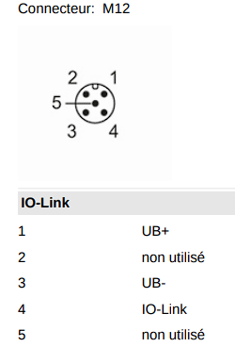
synoptique colonne lumineuse
Alimentation 24 V continue /4A
Passage par le SWITH
Cable IO-Link
X1 : Colonne lumineuse
Colonne lumineuse avec buzzer DV 2131
M221
IO-Link Master DL-MB-8P-IP67
Connectique: 8 Ports avec 16 entrées
Type : Modbus TCP IP
Transmission: 10Mbs
Connecter grâce à un câble Y
*For the configuration of the column, you must first have configured the IO-Link master on LRDevice.

Slide 21
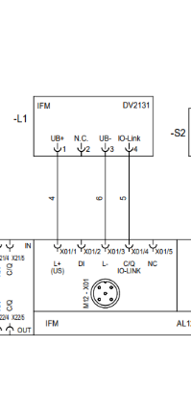
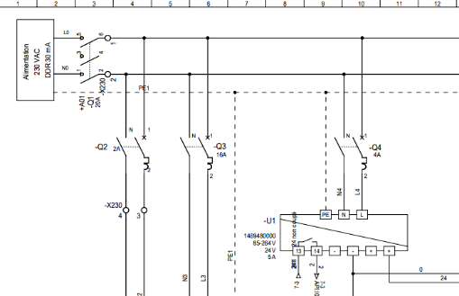
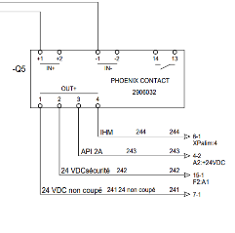
Remonter du schémas électrique depuis la colonne lumineuse
Upstream of the electronic circuit breaker there are: 230/24V transformer; The 4A Q4 circuit breaker; The inter-disconnector.
IO-link master Protected by electronic circuit breaker
Light column on X3 of the IO Link master
2
3
1
The electronic circuit breaker is set to the 24V/4A position
The light tower is plugged into the IO-Link port rated X3

Slide 22
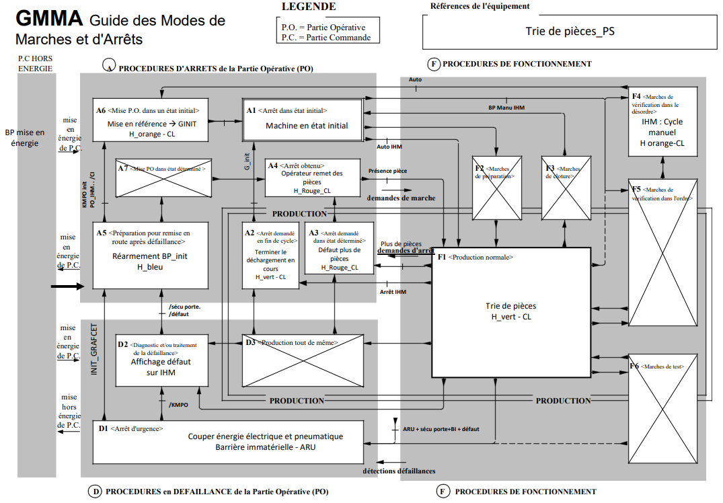

Slide 23
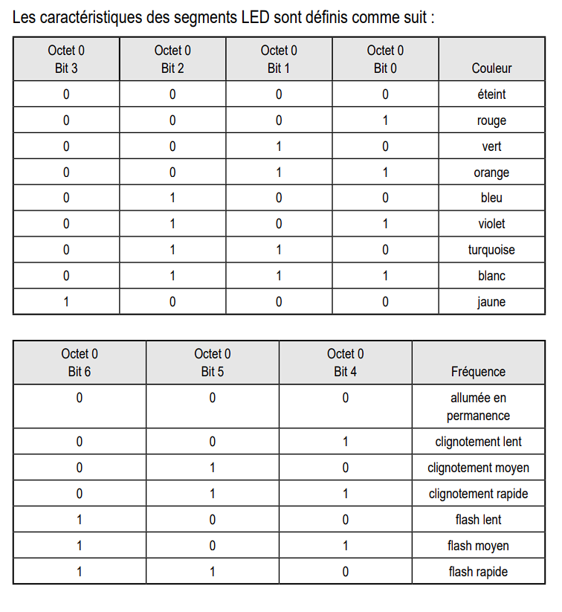
Configuration sur LRDEVICE
Before setting up the machine, we chose the colours: CL Orange: "Manu Mode" / 35(10) Solid Green: "Auto Mode" / 2(10) Green CL: "init" / 34(10) Rouge CL: "judgment in court" / 33(10) CL blue: "operator intervention" / 36(10) = 00100100(2)

Slide 24
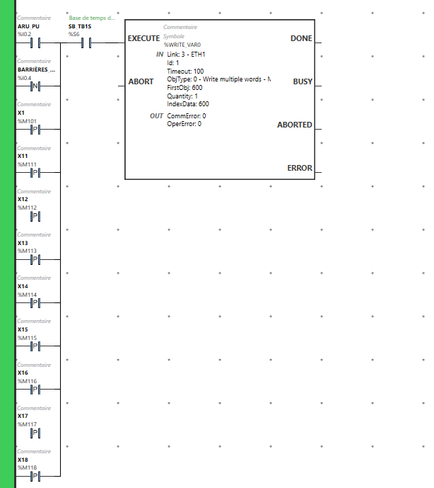
La colonne lumineuse et So- machine basic
Bloc compares. (DRO) This block that allows the light column to know which color/sound to display/emit. The light column reads the word MW600 And in relation to the bit values that will be written, the column will display such and such a color (fixed or flashing)/a sound (with a configurable frequency)
Bit value that changes with respect to the chosen bytes

Slide 25
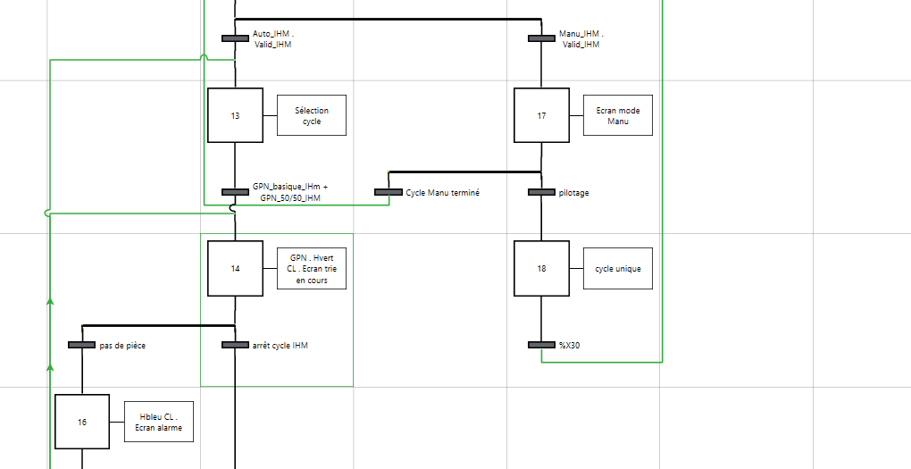
Lien grafcet-colonne lumineuse
Step X14 = write to the 600 register the value 2(10)
Step X16 = write to the register 600 a value of 36 in base 10 (decimal)

Slide 26

Finalité
… By the switch in modbus TCP...
Word transfer via IO-Link cabling
The light column will read the value on the register 600 and will display the desired color
The M221 with respect to the steps of the graph will send a value in binary...
The IO-Link master will convert the value to decimal and write it to the 600 register

Slide 27
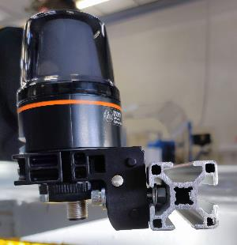
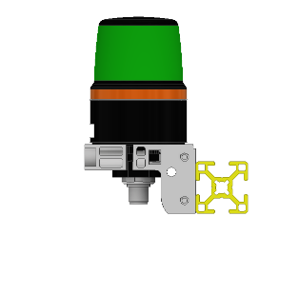
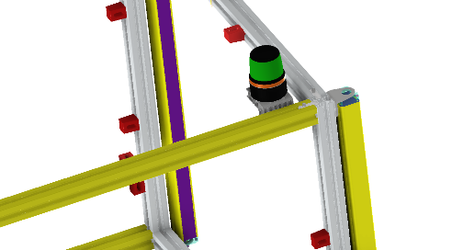

Solution Fixation de la colonne lumineuse
BOSH profile 30X30
The fixing of the light column is done by a right-angled hook from IFM. The support between the fixing and the profile is held in place by means of a screw, two nuts and washers.
Column light DV2131
Mounting bracket (E30421)

Slide 28

Le pupitre

Slide 29

Positionnement du pupitre sur châssis
The console was positioned so that the operator will have a view of the entire machine: Operative part; Light column; OTB; IO-Link Master

Slide 30


Changement pupitre avec arrêt d’urgence + BT INIT PO
solution envisagée
(à hauteur de bassin, accessible à tous)
solution existante
+ BT INIT PO

Slide 31



FIXATION DU PUPITRE
Implementing the Console in CAD
Positioning the holes
Reflection of the fastening system and its location.
Dimensioning and verification of its size on the chassis
591mm
300 mm
391mm

Slide 32



Travail sur le pupitre
IHM
Encombrement du pupitre
Emergency stop
1- Drill bit 2- Hammer 3- Needle 4- Music stand
2
4
Sizing of the lectern
1
3
Init PO
Fixing to the frame after painting.
Perçage

Slide 33



The human-machine interface

Slide 34


L’IHM
The HMI allows the operator to visually communicate information that is essential for the maintenance of the machine and its operation during the cycle.
Port alimentation
PH+N+T
Port Ethernet : 192.168.0.2
USB
5'' TFT display
The HMI program is managed by Vijeo-Designer, a proprietary software owned by Schneider
Vijeo Designer allows you to create operator dialogue applications for operating automation.

Slide 35
Lien avec So Machine Basic
Step graph of screens and light column,

Slide 36



Valeur d’appel écran
Ecran 5
Curepanel ID
The Ihm continuously reads the %MW20 register, Ex: If on the %MW20 register the value is 5. The HMI will display page 5.

Slide 37


Horloge
%SW50 à %SW53
Table of 4 words %MW: -Day -Hours -Minutes -Seconds
Liaison Modbus TCP/IP
Dialogue table

Slide 38




Retour d’alarme
GS
If the word %MW30X2 is activated
The HMI comes to the alarm screen and displays a sentence configured in advance: EX: X2: Default ARU lectern

Slide 39

Câblage IHM
Upstream of the electronic circuit breaker there are: 230/24V transformer; The 4A Q4 circuit breaker; The inter-disconnector.
2
3
1
The electronic circuit breaker is set to the 24V/4A position

Slide 40







Écran 1
Écran 2
Écran 4
CONDITION INITIALE
Écran 7
CI
Écran 5
Écran 6
AUTOMATIQUE
Écran 8
CHOIX CYCLE
Portique
Pince

Slide 41







Pince
Portique
MANUEL
Arrêt
Alarme
Synoptique
Voyant

Slide 42


Connection between the HMI and the m221 controller made through the switch.
"Discussions" between PLC and HMI by pack of 16-bit words every 1S

Slide 43


Slide 44
Remercîment a l’équipe pédagogique
To Mr. Trochut for assisting us in our electrical wiring and programming management; To Mr. Arne for helping us with the CAD/CAD part and tuning the mechanics; To Mr. Thierry for teaching us how to handle tools and machine tools; And to the Plastics Processing Teacher for printing all our parts that we had designed, in 3D printer, And finally a big thank you to all the people who allowed us to spend 2 years of BTS in the best possible conditions.

